Slide 1

Crossing the Disciplinary Divide
Dave Bacon

Slide 2

B.S. Physics and Literature, Caltech (93-97)
Ph.D. Physics, Berkeley (97-01)
Postdoc, Institute for Quantum Information, Caltech (01-04)
Postdoc, Sanfe Fe Institute (04-05)
Scientist, CS, University of Washington (05)
Assistant Research Prof, CS (06-11)
Assistant Research Prof, Physics (07-11)
Software Engineer, Google (11-)

Slide 3
physics
astrophysics
quantum computing
quantum error correction
quantum algorithms
self correcting quantum computers
software development
machine learning

Slide 4
What I Know Now That I Wish I Knew As A Postdoc
A framework for cross disciplinary work in academia
(and how it impacts getting a job, and how you work)
Investing in a dictionary
Freedom, hobbies, and of endeavors of a whimsical nature
Create, create, create, create

Slide 5
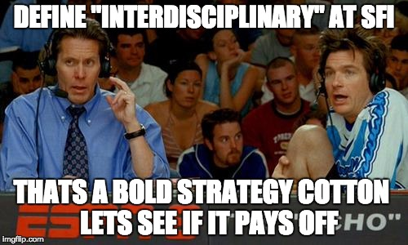

Slide 6
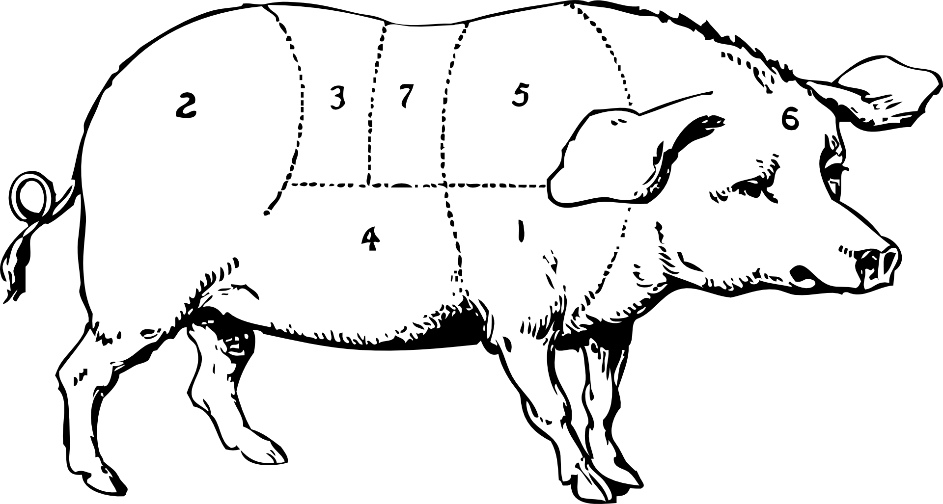
Multidisciplinary
join to solve problems within a discipline
Interdisciplinary
join to form new problems and disciplines
Transdisciplinary
use of other discipline to undermine a discipline

Slide 7
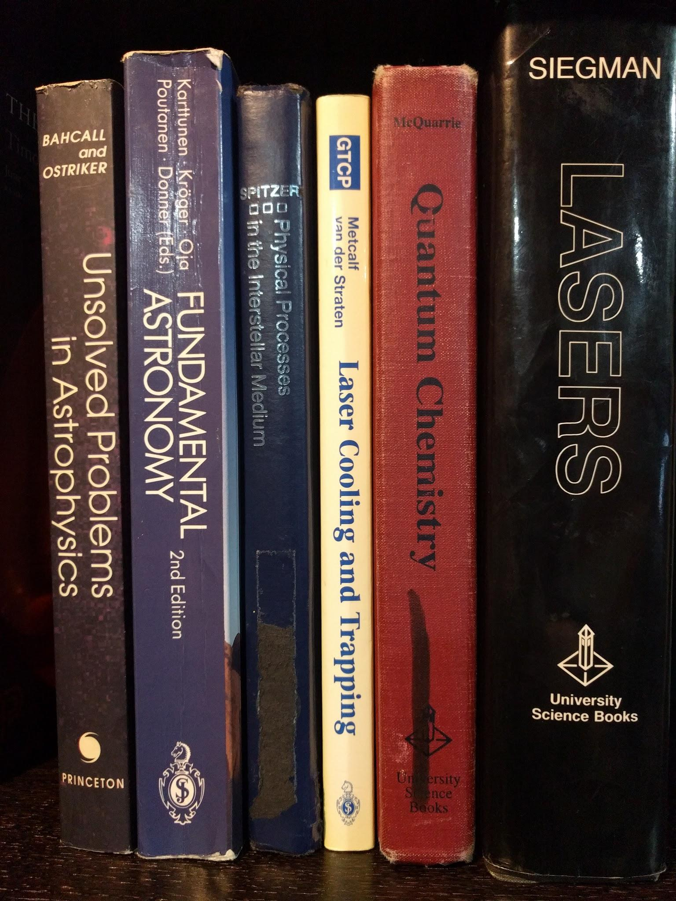
Multidisciplinary
trapping of single molecular ions
+
molecular ions as probe of physics of the interstellar medium
=
better theoretical models of interstellar medium

Slide 8
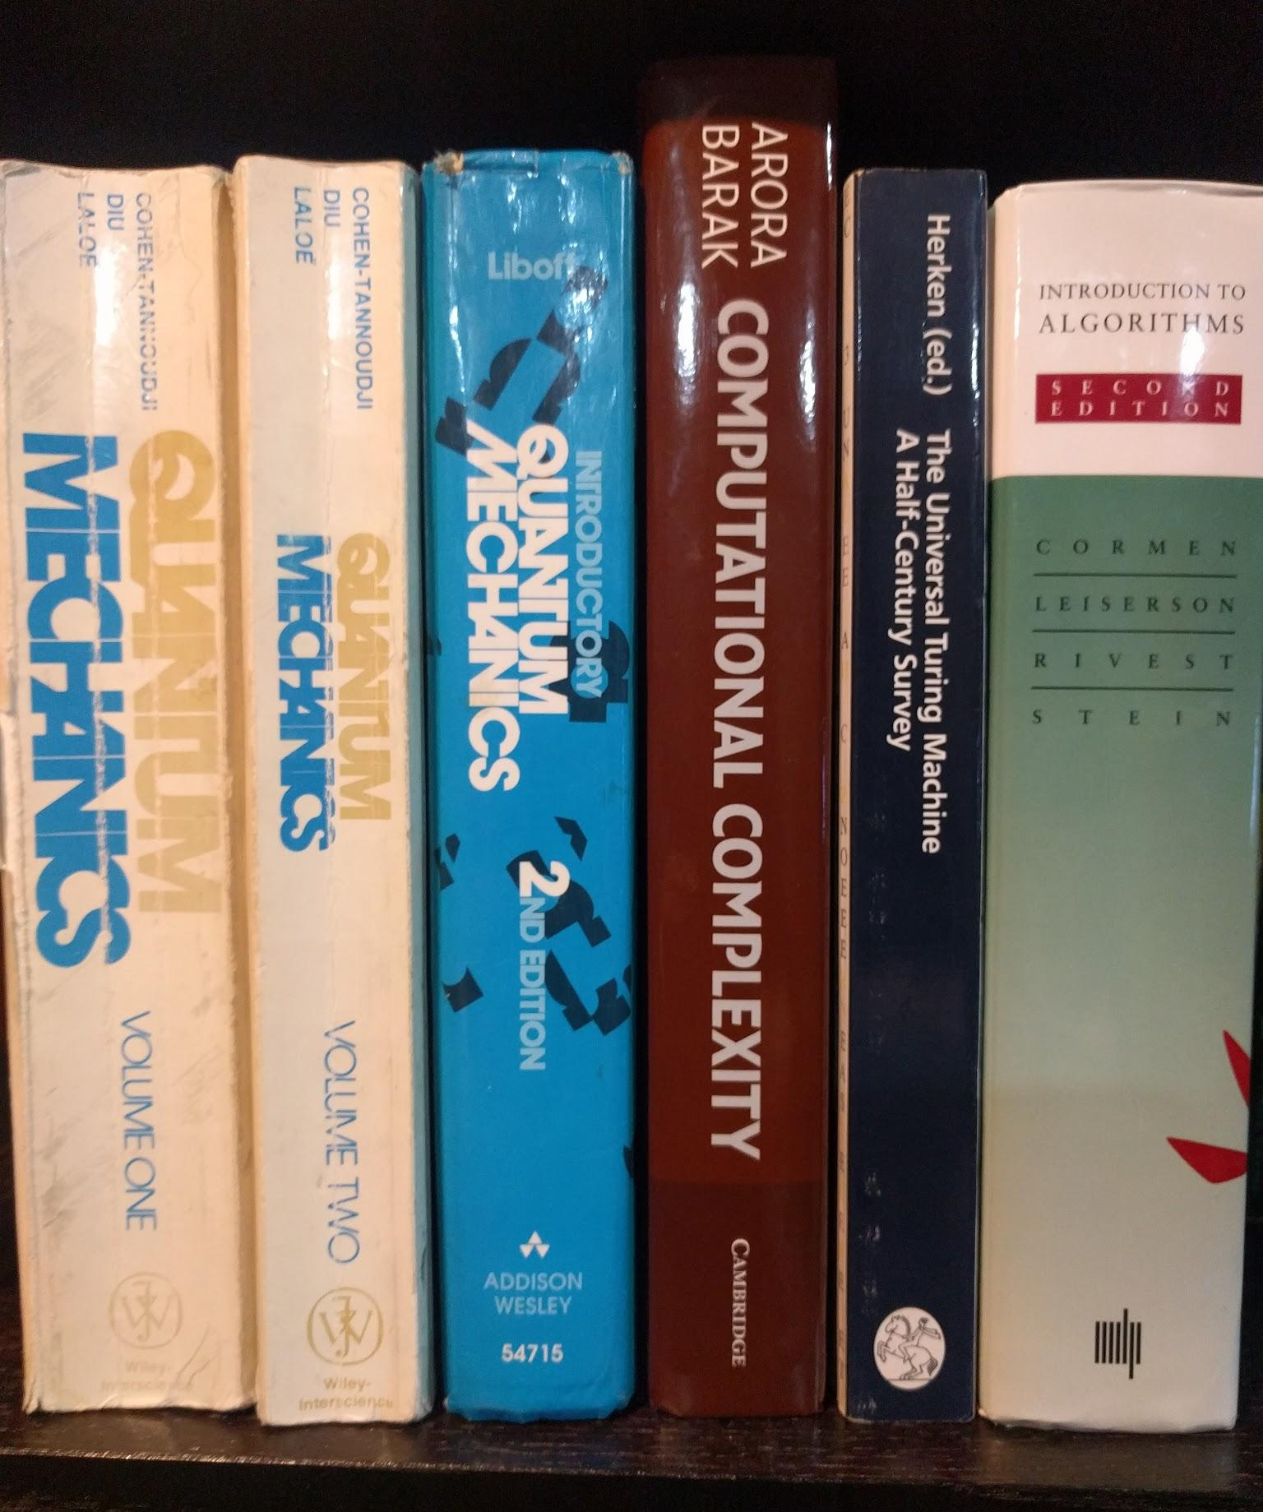
Interdisciplinary
quantum theory of physics
+
theory of computational complexity
=
quantum complexity theory

Slide 9
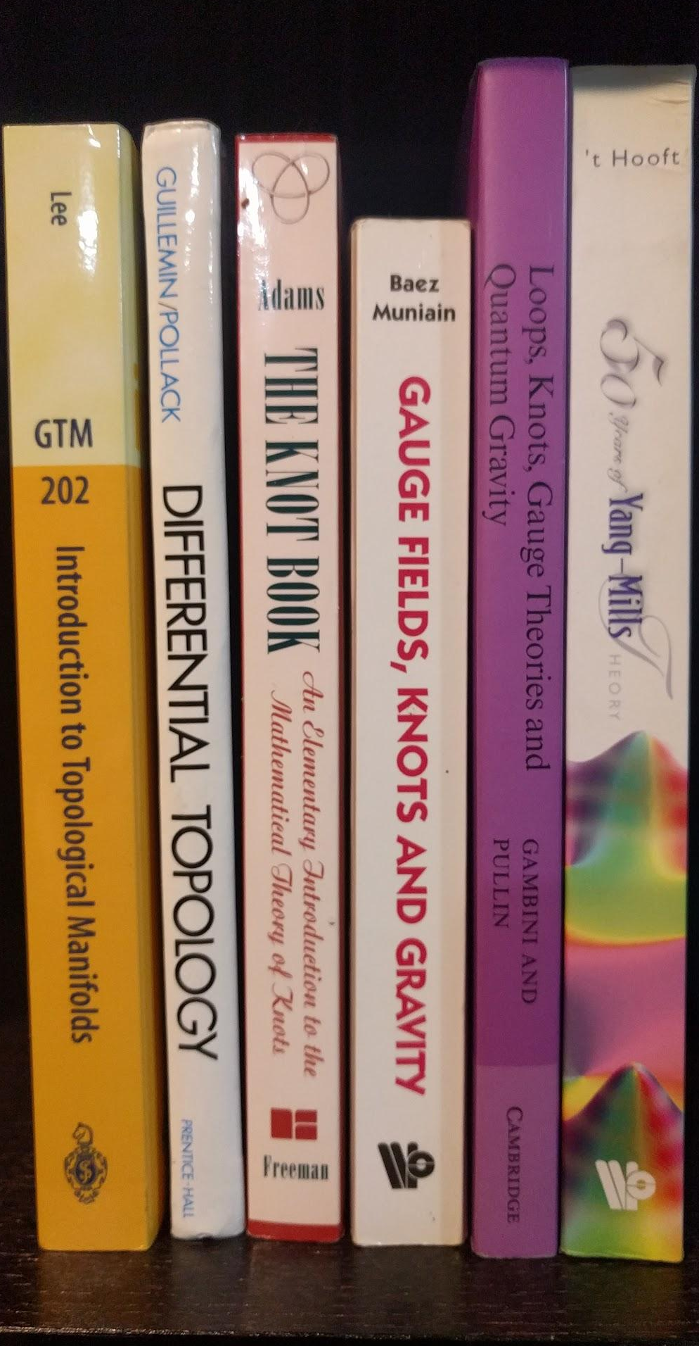
Transdisciplinary
topological quantum field theory
+
theory of knot invariants
=
new basis for theory of knots

Slide 10
Words
Phthi·sis /ˈTHīsəs,ˈtīsəs/
Syz·y·gy /ˈsizijē/
Phil·os·o·nom·i·con /ˈfəˈläsə näm cän/
multidisciplinary
collaborator
new tools
complementary
synergy
interdisciplinary
new field
synthesis
emergent
transdisciplinary
iconoclastic
rebel
transformative

Slide 11
Jobs
Positive
Negative
multidisciplinary
existing disciplines
existing disciplines
interdisciplinary
hot new field
no existing home
transdisciplinary
transformative
threatening

Slide 12

Case Study

Slide 13
Work
multidisciplinary
choosing partners
interdisciplinary
community
transdisciplinary
allies

Slide 14
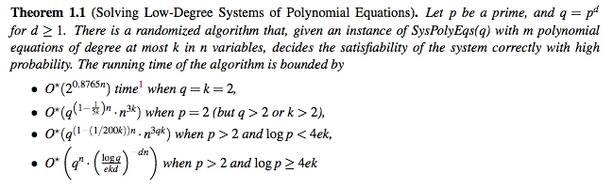
Language
Lokshtanov et al SODA 2017

Slide 15
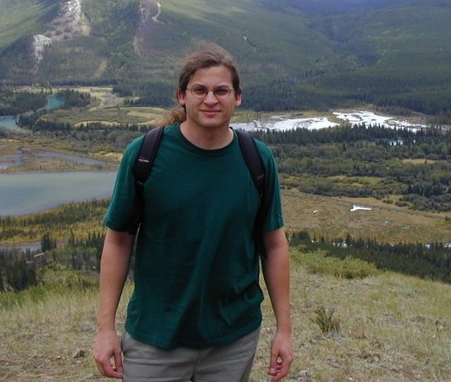
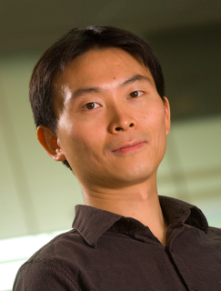
Dictionary
Translation dictionaries open up worlds.
Sean Hallgren
Theoretical CS
Penn State
Yaoyun Shi
Theoretical CS
Michigan

Slide 16
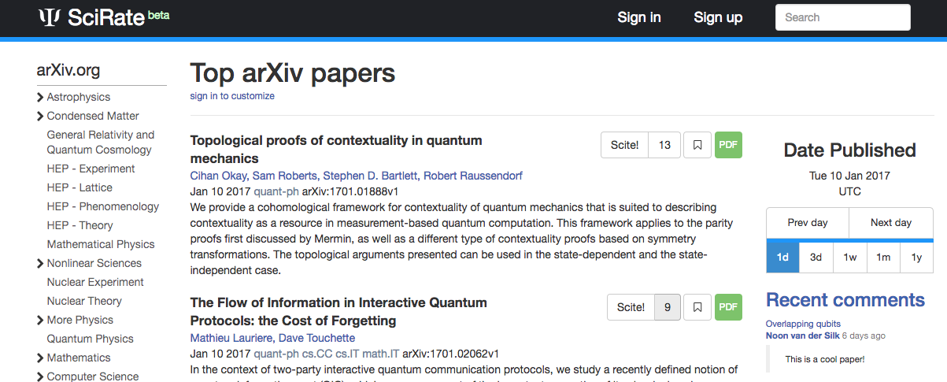
Hobbies

Slide 17

Freedom
“Freedom's just another word for nothing left to lose” - Janis Joplin

Slide 18

Whimsy

Slide 19

Create, Create, Create, Create

Slide 20
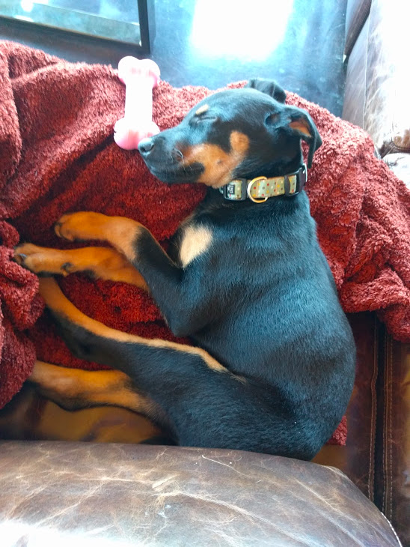
Imma Dog Says Thank You

